Slide 1
SENTIMENT ANALYSIS ON MOVIE REVIEWS
An Internship Report Submitted in Partial Fulfillment of the Requirements for the Degree of
MASTER OF COMPUTER APPLICATION
by
Akash Agarwal
(Univ. no. 2110014325030)
Under the Guidance of
Mr. Ankit Singh
DEPARTMENT OF COMPUTER SCIENCE & ENGINEERING
FACULTY OF ENGINEERING & TECHNOLOGY,
UNIVERSITY OF LUCKNOW, LUCKNOW.
2022 – 23

Slide 2
Introduction- AI can analyse Movie Reviews using Naïve Bayes Algorithm

Slide 3
Objective and Purpose
Determine the polarity of text
Highlighting comments as per their pole

Slide 4
50,000 training examples collected from IMDB 25,000 labeled as Likes 25,000 labeled as Dislikes
Dataset Collection and Cleansing

Slide 6
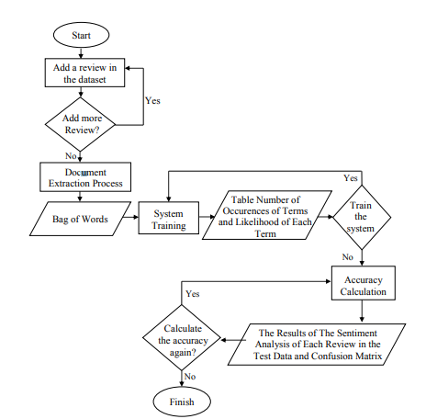
Proposed System

Slide 7
Testing Result
.
Confusion Matrix
Is a summary of prediction results on a classification problem.
N=10000 | Predict Dislike | Predict Like
Actual Dislike | 4387 | 575
Actual Like | 805 | 4233

Slide 8
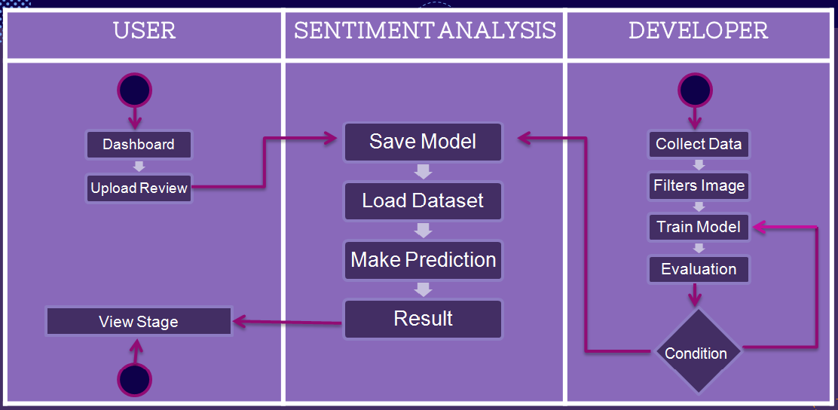
Activity Diagram

Slide 9
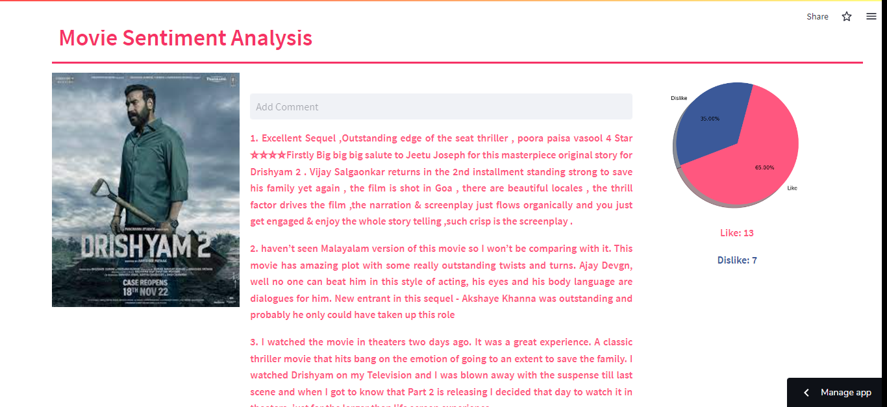
Desktop project
Poster, Reviews and Stats

Slide 10
CONCLUSION
&
FUTURE SCOPE
Naïve Bayes Classifier is used
Accuracy is 86.20%
More data is required
Detecting Sensitivity
Tracking User Opinion

Slide 11
Thank You
सुदिनम् अस्तु

